Slide 1
2024 Panther Lake CRD_ODM Summary Report
Stop
Customers confidential information under NDA, Intel internal use only
Rev1.0, CQ&R CMEE Team, 2024Q3

Slide 2

General SMT Line Layout
Post-Reflow Automated Optical Inspection (AOI)
Pre-Reflow Automated Optical Inspection (AOI) - Optional
Solder Paste Inspection (SPI)

Slide 3
Objectives
Share Findings From CMEE Mobile Industry Data Collection (Panther Lake Platform Customer Survey)
Data Collected From 11 ODM Customers/Sites
  Compal (Kunshan – Build for Dell/HP/Lenovo, Chengdu – Build for Dell, Chongqing – Build for Acer)
  Huaqin (Build for Huawei/Asus/Lenovo/Samsung)
  Inventec Chongqing (Build for HP/Asus)
  LCFC (Build for Lenovo)
  MSI KunShan (Own Brand)
  Pegatron (Suzhou - Build for Microsoft, Chongqing – Build for Asus)
  Quanta (Chongqing – Build for HP)
  Wistron Chongqing(Build for Lenovo)

Slide 4
Agenda
Reliability Test
Functional Test
SMT Process & Rework
Solder paste & Solder ball
Equipment Related
BFI Related
Adhesive Related
Others

Slide 5
Highlights
All customers perform TC/Shock/ Thermal Humidity test, but thermal test conditions were different
Thunderbolt is the most difficult feature to test and causes most false failures. Most ODMs don’t know how to test AI.
Most customers follow Intel MAS guidance for land pattern creation. Please make sure the reference board is consistent with the land pattern in MAS!
Less than half ODMs use NCTF testable pin design for testing. Half of them prefer NCTF testable pins to be connected to GND plane. All ODMs hope to keep NCTF testable feature.
Only Pegatron Suzhou used to use recycled Tin solder paste Senju M705R S101-N4, requested by MSFT. Reliability and cost are the main concern.
Half customers hope Intel don’t remove solder paste recommendation in MAS, otherwise they have to qualified by themselves.
TI uses SAC105, AMD uses SAC305, Qualcomm uses SAC405. Most customers concern on the soldering quality if Intel change SAC405 to SAC305 and will do some qualifications.
Most customers don’t use dosimeter for X-ray exposure measurement.
All customers apply adhesives to Intel BGAs except Pegatron Suzhou(MSFT ODM).

Slide 6
Reliability Test

Slide 7
Reliability Test(1 Of 4)
 | Do you perform reliability test for your product? | When do you decide to perform reliability test? | Do you do Thermal Cycle (TC) test? | TC test details?
LCFC | Yes | For every project | Yes | Board level, -40°C~65°C, 15 ℃/min, dwell 8 min, sample size:10, 678cycles basic requirement，1000cycles is extended requirement
Compal CD | Yes | For every project | Yes | Both system level and board level, System level: -40°C~65°C, > 30 °C/min, dwell 20 min, 5 units/ Monthly /model, 50 cycles Board level: -40°C~85°C, > 30 °C/min, dwell 15 min, 30 pcs or 1 full chamber filled boards /month/platform, 100 cycles
Huaqin | Yes | For every project | Yes | System level, -22°C~50°C, 10 ℃/min, dwell 30 min, sample size:5, 50 cycles
Inventec CQ | Yes | For every project | Yes | No reply from customer due to NDA
MSI | Yes | For every project | Yes | Board level, -30°C~60°C, 30 ℃/min, dwell 60 min, sample size:2, 5 cycles
Pega SZ | Yes | Only when new form factors or new process were introduced | Yes | No reply from customer due to NDA
Compal KS | Yes | For every project | Yes | EVT: board level, -40°C~85°C, 40±5°C/min, dwell 15 min, 20 pcs(reworked*10pcs+non-reworked*10pcs), 1000 cycles DVT: system level: -40°C~65°C, 40±5°C/min, dwell 20 min, Minimum 3pcs, 1000 cycles
Quanta CQ | Yes | For every project | Yes | No reply from customer due to NDA
Pega CQ | Yes | Depends on customer's requirements | Yes | Board level, -40°C~100°C, 15-30 ℃/min, dwell 20-30 min, sample size:53, 630 cycles
Compal CQ | Yes | Depends on customer's requirements | Yes | System level, -40°C~65°C, ＞20 ℃/min, dwell 2 hours, 16 cycles
Wistron CQ | Yes | Choose one or several projects in each generation, and when new form factors or new process were introduced | Yes | Board level, -40°C~85°C, > 40℃/min, dwell 15 min, sample size:20, 1000 cycles
All customers perform TC test, but thermal test conditions and sample size were different.

Slide 8
Reliability Test(2 Of 4)
 | Do you perform shock test? | If yes, do you do shock test at system level or board level? | If yes, what is the sample size you normally used for shock test? | Do you monitor the acceleration and shock wave in your shock test, if yes, what is the G level and wave spec?
LCFC | Yes | System level | No reply from customer | No reply from customer
Compal CD | Yes | System level | 2 Pcs/monthly/model | 140G, 2ms
Huaqin | Yes | System level | 3 Pcs | 245G, 2ms, half sine pulse(Shock test)
Inventec CQ | Yes | System level, in package box | No information from factory side. | No reply from ODM due to NDA
MSI | Yes | System level | 2~4 Pcs | No
Pega SZ | Yes | System level and board level | No information from factory side. | No information from factory side.
Compal KS | Yes | System level: Operational Random Vibration Test Board level: Halt Test/PKG vibration test | Operational Random Vibration: Design Qual Minimum 2pcs Halt test: Design Qual Minimum 4pcs PKG vibration test: refer to shipping plan | Operational Random Vibration:0.66G half sine pulse Halt:(30~70G or higher) TTF PKG vibration:1.146G half sine pulse
Quanta CQ | Yes | System level | No reply from ODM due to NDA | No reply from ODM due to NDA
Pega CQ | Yes | System level | 22 Pcs | Trapezoidal 25g , 250 inch/sec
Compal CQ | Yes | System level | 2 Pcs/SKU | op shock test: system power on, Amplitude: 105G, Duration: 2 ms, Wave form: Half-sine non-op shock test: system power off, Amplitude: 220G, Duration: 2 ms, Wave form: Half-sine
Wistron CQ | Yes | Board level | 8 Pcs | No reply from customer
Most customers perform shock test at system level, the test conditions were different. Some customers perform vibration test only.

Slide 9
Reliability Test(3 Of 4)
 | Do you perform Thermal Humidity (TH) Test? (Double 85 test)? | If yes, do you do TH test at system level or board level? | What is your total test time of TH test?
LCFC | Yes | Board level | 500 hours
Compal CD | Yes | System level | 100 hours
Huaqin | Yes | Board level | 300 hours
Inventec CQ | Yes | System level | No information from factory side.
MSI | No | NA | NA
Pega SZ | Yes | No information from factory side. | No information from factory side.
Compal KS | No | NA | NA
Quanta CQ | Yes | System level | No reply from customer
Pega CQ | Yes | System level and board level | 500 hours
Compal CQ | Yes | System level | Non-operating Temperature and Humidity Test: 51hours Package Storage Test :120hrs
Wistron CQ | No reply from customer | No reply from customer | No reply from customer
Most customers perform Thermal Humidity test, but test conditions were different.

Slide 10
Reliability Test(4 Of 4)
 | Any other reliability test you perform except above 3 mentioned tests? If yes, please specify the test name, test condition, sample size and passing/failing criteria | Are the tests run on daisy chain parts/boards or functional parts/boards? | What board thickness will be used for the tests? | Is the test run on bare boards, or run on bare boards with thermal solution attached, or run inside a fully populated system/chassis?
LCFC | HT storage，125c，600h | Daisy chain and functional boards | Depends on product design | Bare boards
Compal CD | ESD/EMC | Functional boards | 0.8 mm | System/Chassis
Huaqin | Vibration Test Random Vibration: 0.025 g2/Hz, 10-500 Hz, nominal 3.5 grms. | Functional boards | 0.8 mm and 1mm | System/Chassis
Inventec CQ | No reply from ODM due to NDA | No reply from ODM due to NDA. | No reply from ODM due to NDA | No reply from ODM due to NDA
MSI | Display swing 12500 times, 2-4 Pcs to check whether torque force failure, flash screen or blue screen; drop test, 76 cm, 2 pcs to check whether package crack, PC damage and basic functions | Functional boards | 1.2 mm | Boards with thermal solution attached + system/chassis
Pega SZ | No information from factory side. | No information from factory side. | No information from factory side. | Bare boards+ system/chassis
Compal KS | Please refer to REL1078 durability requirement document | Functional boards | Portofino(project name): 0.6mm | Bare boards+ system/chassis
Quanta CQ | No reply from ODM due to NDA | No reply from customer | No reply from customer | No reply from customer
Pega CQ | Vibration, 5Hz to 500Hz 2.2g 22 pcs, functional pass and D&P and X-section pass | Functional boards | Depends on product type，0.8-1.0mm | Boards with thermal solution attached + system/chassis
Compal CQ | No reply from customer | No reply from customer | Depends on product | System/Chassis
Wistron CQ | No reply from customer | No reply from customer | Depends on product | No reply from customer

Slide 11
Functional Test

Slide 12
Functional Test(1 Of 3)
 | Are ICT testers used? | If yes, please provide ICT tester model | If not, what other assembly test methodology do you use prior to functional test? | Do you use any type of USB-based functional test? | If yes, what kind of fixture it is?
LCFC | Yes | NA | NA | Yes | Board flat with cable(s) plugged in to a USB or other connector
Compal CD | Yes | Keysight i3070/Teradyne TSHL52 | AOI(Small board without test point, only do AOI) | Yes | Board flat with cable(s) plugged in to a USB or other connector
Huaqin | Yes | TR5001D | NA | Yes | Board flat with cable(s) plugged in to a USB or other connector
Inventec CQ | Yes | TR800 | NA | Yes | Board flat with cable(s) plugged in to a USB or other connector
MSI | Yes | JET3000 | NA | Yes | Special test fixture
Pega SZ | Yes | Keysight 3070 | NA | Yes | Board flat with cable(s) plugged in to a USB or other connector
Compal KS | No | NA | No reply from customer | Yes | Board flat with cable(s) plugged in to a USB or other connector
Quanta CQ | Yes | No reply from customer | No reply from customer | Yes | Board flat with cable(s) plugged in to a USB or other connector
Pega CQ | No | NA | MDA test | Yes | Board flat with cable(s) plugged in to a USB or other connector
Compal CQ | Yes | Keysight 3070 | NA | Yes | Board flat with cable(s) plugged in to a USB or other connector
Wistron CQ | Yes | Keysight 3070 | NA | Yes | Automated test equipment
Most customers use ICT tester. Keysight is the most popular ICT tester, all customers have USB-based functional test.

Slide 13
Functional Test(2 Of 3)
 | How many times is assembly test done before thermal solution attach? | How are boards transported between all assembly and test process steps? | Are boards held vertically in racks or lay flat in a tray? | Can the customer provide images of the method(s) used to transport boards
LCFC | No reply from customer | Box + trolly | Vertical | NA
Compal CD | 2 | SMT conveyer belt | Lay flat
Huaqin | 3-6 | Tray | Lay flat | NA
Inventec CQ | 2 | Box | Lay flat
MSI | 3 | Trolly + Anti-static box | Vertical and flat
Pega SZ | 2 | Tray | Lay flat | NA
Compal KS | 2-3(BFT test, basic function test before Rel test, rework test) | Tray | Lay flat
Quanta CQ | 2 (ICT, function) | Tray | Lay flat | NA
Pega CQ | 2-3(MDA test/functional test, rework test) | SMT conveyer belt | Lay flat | NA
Compal CQ | 1 | Tray | Lay flat | NA
Wistron CQ | 3-6 | Tray | Lay flat | NA
Customer tested 1-6 times before thermal solution attach.
Most customers use tray and lay flat when transport boards.

Slide 14
Functional Test(3 Of 3)
 | Which feature is the most difficult to test or causes the most false failures? | Which SW or HW tools used for functional testing of peripheral and functional modules in MB needs to be improved? | Do you have any difficulty knowing how to test the functionality of AI features? | If yes, please state what is the difficult you are experiencing?
LCFC | No reply from customer | No reply from customer | No reply from customer | No reply from customer
Compal CD | USB，HDD | NA | No | NA
Huaqin | Thunderbolt, type C | Thunderbolt, type C | No | NA
Inventec CQ | CPU, thunderbolt | NA | NA | NA
MSI | Thunderbolt | Thunderbolt has a lot of functions, need to test a lot of times and very time-consuming | No | NA
Pega SZ | RF, USB | NA | NA | NA
Compal KS | Thunderbolt, VGA | Thunderbolt | NA | NA
Quanta CQ | No reply from customer | No reply from customer | No reply from customer | No reply from customer
Pega CQ | Thunderbolt/USB3.1 | Thunderbolt/USB3.1 | NA | NA
Compal CQ | No reply from customer | No reply from customer | No reply from customer | No reply from customer
Wistron CQ | HDMI | USB | No | NA
Thunderbolt is the most difficult feature to test and causes most false failures.
Most ODMs don’t know how to test AI.

Slide 15
SMT Process & Rework

Slide 16
SMT Process & Rework(1 Of 6)
 | Do you follow the Intel MAS adhesive KOZ? | What KOZ is implemented to ensure Intel BGA rework? | Do you follow Intel MAS/PDG guidance for the SOC land pattern creation? | How close do you allow passive components to be placed around the SOC site(for rework consideration)
LCFC | Yes | No reply from customer | Yes | No reply from customer
Compal CD | Yes | If other parts next to BGA ＜2 mm, the minimum rework requirement is 2 mm, if ＞2 mm, minimum requirement is 3 mm | Yes | If other parts next to BGA ＜2 mm, the minimum rework requirement is 2 mm, if ＞2 mm, minimum requirement is 3 mm
Huaqin | Yes | 1.5mm | Yes | 1.5mm
Inventec CQ | Yes | 1mm | Yes | 1mm
MSI | Yes | ＞1.25 mm | Yes, follow Intel reference board | ＞1.25 mm
Pega SZ | No, most SOC don't have adhesive | 1.7 mm | Yes, follow Intel reference board | 1.7 mm
Compal KS | Yes | No reply from customer | Yes, follow Intel reference board, please make sure reference board is same with MAS | No reply from customer
Quanta CQ | Yes | No reply from customer | Yes, follow Intel reference board | No reply from customer
Pega CQ | Yes | 2 mm | Yes | 2 mm
Compal CQ | Yes | No reply from customer | Yes, follow Intel reference board | No reply from customer
Wistron CQ | Yes | 1.5mm | No reply from customer | 1.5mm
All customers follow Intel MAS adhesive KOZ, but the requirement for rework is different, range from 1 mm to 2 mm.
Most customers follow Intel land pattern guidance by referring to Intel reference board. Thus, it is critical to make sure the reference board is consistent with the land pattern in MAS!

Slide 17
SMT Process & Rework(2 Of 6)
 | What is your board surface finish? | Do you use SMT Pallets (from printing through reflow) or is each separate? | Have you placed small passive parts underneath a taller SMT part? | If N2 is used at reflow, what is the specific O2 PPM setting?
LCFC | OSP | Only use reflow pallet | No (except the shielding can) | <1000 ppm
Compal CD | OSP | Only use reflow pallet | No | <=3000 ppm
Huaqin | OSP | Some projects used pallet for all process, some use reflow pallet only | No | 1000~3000 ppm
Inventec CQ | ENIG and OSP | From printing through reflow | Yes | <=3000 ppm
MSI | ENIG and OSP | Only use reflow pallet | No | <1000ppm
Pega SZ | ENIG and OSP | From printing through reflow | Yes, we print small passive parts under the shielding can | <=4000PPM
Compal KS | OSP or OSP + Selective ENIG | Only use reflow pallet | Yes | <=4000PPM
Quanta CQ | OSP | Only use reflow pallet | Yes, only tried in NPI, not used in HVM | 1000 PPM
Pega CQ | OSP | From printing through reflow for board thinner than 0.8 mm, otherwise only use reflow pallet | No | ≤3000 ppm
Compal CQ | OSP | Only use reflow pallet | No | ≤3000 ppm
Wistron CQ | OSP | Only use reflow pallet | No | <=1000 ppm
Most customers use OSP board and reflow pallet.
Few ODMs have experience on placing small passive parts underneath a taller SMT parts.
Q2 PPM range from 1000 PPM to 4000 PPM.

Slide 18
SMT Process & Rework(3 Of 6)
 | Do you aware Intel Client BGA has NCTF testable pin designed to make it possible to detect solder joint crack use continuity test (ICT or manual probe)? | Do you apply corner NCTF solder joint open detection design in your mother board? | If yes, what percentage of your designs implemented this kind of design? | Do you prefer the NCTF testable pins to be connected to Ground plane or PWR plane ?
LCFC | Yes | Yes | All products | GND plane
Compal CD | No | No | NA | NA
Huaqin | Yes | No | NA | NA
Inventec CQ | Yes | Yes | Only Lunar Lake | GND plane
MSI | Yes | Yes | All products | No preference – both are OK
Pega SZ | No information from factory side | No information from factory side | No information from factory side | No information from factory side
Compal KS | Yes | Yes | All products | No preference – both are OK
Quanta CQ | No reply from customer | No reply from customer | No reply from customer | No reply from customer
Pega CQ | Yes | No | NA | NA
Compal CQ | No | No | NA | NA
Wistron CQ | No reply from customer | No reply from customer | No reply from customer | No reply from customer
Less than half ODMs use NCTF testable pin design for testing. Half of them prefer NCTF testable pins to be connected to GND plane.

Slide 19
SMT Process & Rework(4 Of 6)
 | Do you think it is a ‘must to have’ NCTF feature for future Intel BGA package design? | If ‘must to have’ or ‘nice to have’, what is the minimum QTY of NCTF testable pins you think are needed for each corner?
LCFC | Must to have | 2
Compal CD | Nice to have | 1
Huaqin | Nice to have | 2
Inventec CQ | Nice to have | 2
MSI | Nice to have | ＞2
Pega SZ | No information from factory side | No information from factory side
Compal KS | Nice to have | 30-40
Quanta CQ | No reply from customer | No reply from customer
Pega CQ | Nice to have | ＞2
Compal CQ | Nice to have | ＞2
Wistron CQ | No reply from customer | No reply from customer
All ODMs think it is nice to keep NCTF testable feature.

Slide 20
SMT Process & Rework(5 Of 6)
 | What is your rework process preferred to repair full grid array SOC devices? | Do you have the capability to do paste jetting for rework BGA | If yes, what is the minimum KOZ for your paste jetting process?
LCFC | Solder paste printed with a ministencil | No | NA
Compal CD | Solder paste printed with a ministencil and Solder paste printing on the component solder ball | No | NA
Huaqin | Solder paste printed with a ministencil | No | NA
Inventec CQ | Solder paste printed with a ministencil | No | NA
MSI | Solder paste printed with a ministencil | No | NA
Pega SZ | Solder paste printed with a ministencil | No | NA
Compal KS | Solder paste printed with a ministencil/paste jetting. Paste jetting rework tooling response is product specific (LTS pkg), but their baseline process is mini-stencil rework. | Yes | 2 mm
Quanta CQ | Solder paste printed with a ministencil | No | NA
Pega CQ | Solder paste printed with a ministencil | No | NA
Compal CQ | Solder paste printed with a ministencil | No | NA
Wistron CQ | Solder paste printed with a ministencil | No | NA
All customers prefer mini-stencil to rework, only Compal KS has paste jetting machine and minimum KOZ is 2 mm.

Slide 21
SMT Process & Rework(6 Of 6)
 | Do you use any fixturing /pallets for the rework process? | If yes, what is the material of fixturing /pallets? | What is your prefer method to remove the solder paste residues after SOC removal from the board, do you do manual site dress or auto-scavenging?
LCFC | Yes | Aluminum, synthetic stone | Manual remove
Compal CD | Yes | Synthetic stone | Manual remove
Huaqin | Yes | Synthetic stone | Manual remove
Inventec CQ | Yes | Aluminum | Manual remove
MSI | Yes | Aluminum | Manual remove
Pega SZ | Yes | Aluminum or durostone | Most are manual remove, the automated machine is not good for use, VTTECH/VT-610S
Compal KS | Yes | Aluminum or durostone | Manual remove
Quanta CQ | Yes | SST | Manual remove
Pega CQ | Yes | Aluminum | Manual remove
Compal CQ | Yes | Aluminum | Manual remove
Wistron CQ | Yes | Aluminum | Manual remove and auto-scavenging
Most customers use Aluminum or Synthetic stone to make pallets. And manual remove is the most popular way to remove the solder paste residues.

Slide 22
Solder paste & Solder ball

Slide 23
Solder paste & Solder ball (1 Of 4)
 | Have you ever utilized Recycled Tin solder paste or solder bars in your HVM factories? | If you have utilized Recycled Tin Solder paste or solder bars, which suppliers and formulations have you used? | Would you consider utilizing Recycled Tin Solder paste or solder bars in your products to support sustainability efforts? | What is the primary reason for not considering utilizing Recycled Tin Solder paste or solder bars?
LCFC | So Far No | Tried Senju | Depends on OEM requirement | Reliability
Compal CD | No | NA | No | Reliability
Huaqin | No | NA | Yes | Reliability, cost
Inventec CQ | No | NA | No | Reliability
MSI | No | NA | No | Reliability
Pega SZ | Yes | Senju M705R S101-N4 | NA | NA
Compal KS | No | NA | No reply from customer | No reply from customer
Quanta CQ | No | NA | No | Depends on customer requirement
Pega CQ | No | NA | No | Reliability
Compal CQ | No | NA | No | Reliability
Wistron CQ | No reply from customer | No reply from customer | No reply from customer | No reply from customer
Only Pegatron Suzhou used to use recycled Tin solder paste Senju M705R S101-N4, requested by MSFT. Reliability and cost are the main concerns.

Slide 24
Solder paste & Solder ball (2 Of 4)
 | Will there be impact if we remove the solder paste vendor/model list recommendation from MAS ? | If yes, what is the impact?
LCFC | Yes | Intel has tested the NWO, HOP risk of the recommended solder paste in MAS
Compal CD | Yes | Customer will check whether ODM's solder paste was recommended by Intel, if not, ODM need to provide DOE result of the solder paste
Huaqin | No, our solder paste was verified by OEM | NA
Inventec CQ | No, we follow OEM's advice to use solder paste | NA
MSI | No | NA
Pega SZ | Yes | Customer request Intel to provide paste recommendation; Have to qualify (how long it takes?) our own paste instead of choosing from Intel's recommendation list
Compal KS | Yes | When analyze solder issues, we will take Intel recommendation for reference
Quanta CQ | No, we follow OEM's advice to use solder paste | NA
Pega CQ | Yes | Customer request Intel to provide paste recommendation; Have to qualify our own paste
Compal CQ | Yes | Have to qualify our own paste
Wistron CQ | No reply from customer | No reply from customer
Half customers hope Intel don’t remove solder paste recommendation in MAS, otherwise they have to qualified by themselves. Others follow OEM’s request.

Slide 25
Solder paste & Solder ball (3 Of 4)
 | What % of non-Intel BGAs do you currently assemble with SAC305 solder balls? | Do you have any concerns if Intel switch BGA solder balls from SAC405 to SAC305 metallurgy? | Would any new qualifications need to be done if Intel do this change?
LCFC | No data | Need further verification, Intel can also try SAC 105 | Yes, will do some verification
Compal CD | TI use SAC105 | Need to confirm the wetting performance, strength and reliability of the solder ball | Yes
Huaqin | No data | Need to confirm the reliability under double 85 | Yes
Inventec CQ | AMD use SAC 305, Qualcomm use SAC405 | Need to confirm the influence on soldering | Yes
MSI | 90% | Yes, we think SAC405 has better wetting capability and thermal shock performance compared to SAC305 | We recommend not to change
Pega SZ | No data | Yes, need do reliability test. | Yes
Compal KS | 98% | No reply from customer | No reply from customer
Quanta CQ | No reply from customer | Reliability | No
Pega CQ | 100% | Need to confirm the quality of solder joint | Yes
Compal CQ | 90% | Need to confirm the open, SBB risk of SAC305 | X-section, DnP
Wistron CQ | No reply from customer | No reply from customer | Yes
TI uses SAC105, AMD uses SAC305, Qualcomm uses SAC405. Most customers worry about the soldering quality and reliability if Intel change SAC405 to SAC305 and will do some qualifications.

Slide 26
Solder paste & Solder ball (4 Of 4)
 | What is the largest void size in BGA solderjoint allowed? | How often do you find SAC BGA in HVM that have solder joint cumulative void size >30%? | If you find a SAC BGA solder joint with cumulative void size >30%, what action(s) do you take?
LCFC | Depends on product | Sometimes | Rework
Compal CD | Follow IPC610, less than 30% | Never | Adjust the reflow profile and stencil
Huaqin | 30% | Sometimes | Adjust the reflow profile and stencil
Inventec CQ | 30% | Sometimes | Adjust the reflow profile and stencil
MSI | 30% | Never | Adjust the reflow profile and stencil
Pega SZ | 30% | Sometimes | No adjustment, only if high FR
Compal KS | 30% | Never | Optimize the process setting
Quanta CQ | 20% | Never | NA
Pega CQ | 30% | Only find in LNL | Adjust the reflow profile, but the result is not very good
Compal CQ | 30% | Never | NA
Wistron CQ | ＜25% | Sometimes | Adjust the reflow profile and stencil
Most customers follow 30% spec to inspect void size, except Quanta and Wistron. Half customers used to find void >30%. Adjust the profile and stencil is the most popular actions if they find void >30%.

Slide 27
Equipment Related

Slide 28
Equipment Related(1 Of 4)
 | Is MXI Inspection used in your line? | If MXI is used, what is the purpose? | What is the tube Voltage and Power of the MXI machine used for inspection | What is the MXI Inspection time for PCBA with SOC housing a memory
LCFC | Yes | FA, rework, process set-up | 90 KV, 7.65 W | 3 minutes
Compal CD | Yes | Rework validation, process set-up | 160KV , 3W | No LNL projects
Huaqin | Yes | Rework validation, process set-up | 60KV, 2400W | 1 minutes
Inventec CQ | Yes | Rework validation | 120kV, 2W | 2 minutes
MSI | Yes | FA, rework, process set-up | 130KV/40W | 3 minutes
Pega SZ | Yes | FA, rework, process set-up | 120kV, 14W | 3 minutes
Compal KS | Yes | FA, rework, process set-up | 120KV, 1.6 W | 5 minutes
Quanta CQ | Yes | Process set-up | 120 KV, 3.8W | Unknow
Pega CQ | Yes | Rework, process set-up | Nanofocus focus size:1um, max power: 1W Microfocus focus size: 2um, max power: 7W High Power focus size: 6um, max power: 12W | 2 minutes
Compal CQ | Yes | FA, rework validation, process set-up | 120kV, 10W | 5 minutes
Wistron CQ | Yes | Sampling check, P/R check, rework validation | 160KV,20W | 5 minutes
All customers use MXI for FA, rework, process set-up. The Voltage and Power settings are different, since different machines were used. Inspection time range from 1 min to 5 min.

Slide 29
Equipment Related(2 Of 4)
 | Do you have access to a dosimeter for X-ray exposure measurements in MXI? | If yes, please mention the supplier, dosimeter product name and accuracy of the dosimeter | Do you have issues with inspecting the package with the package facing away from the X-ray source in MXI? Please mention the issues.
LCFC | No | NA | No
Compal CD | No | NA | No
Huaqin | No | NA | No
Inventec CQ | Yes | NA | No
MSI | No | NA | No
Pega SZ | Yes | Nanodot(???) | No
Compal KS | No reply from customer | NA | No
Quanta CQ | Yes | Nanodot(???) | No
Pega CQ | No | NA | No
Compal CQ | No | NA | No
Wistron CQ | No | NA | Yes, shielding cap and backside components will affect inspection
Most customers don’t have any experience on dosimeter for X-ray exposure measurement. Only Wistron have issues with inspecting the package with the package facing away from the X-ray source.

Slide 30
Equipment Related(3 Of 4)
 | Please provide current Mfg. Name, Model #, Model Year/Date for Solder Paste Print machine (SMT Printer) | Please provide current Mfg. Name, Model #, Model Year/Date for Solder Paste Inspection machine (SPI) | Please provide current Mfg. Name, Model #, Model Year/Date for PNP machine
LCFC | Hitachi: MS-710(NB) DEK: 03ix GEMINI | KoHYoung: KY8030XDL Truteck : TU-521 | Panasonic: NPM-D/TT2 ASM Siplace: X4iS&X3S
Compal CD | GKG ,2018,2021 | hollly D686 2020 | Panasonic D3, DX,TT2
Huaqin | 1.Brand：GKG：Type：GT++，Year：2020 2.Brand：MPM：Type：MPM-100，Year：2020 | 1.Brand：Sinic-Tek：Type：Hero-S，Year：2020 | Brand：Panasonic, Type：NPM-D3/NM-EJM6D，Year：2020
Inventec CQ | DEK/GKG | SINIC-TEK | NPM/CM
MSI | Brand: ASM, Type: NeoHorizon 03ix, Year：2021 | Brand: TRI, Type：TR7007 SII Plus, Year：2021/08 | Brand：Fuji, Type：NXT Ⅲ, Year：2021
Pega SZ | DEK | TR7007A JUTZE | Panasonic D3 NM NXT-FUJI M3
Compal KS | GKG,GT+,2017/18 | Holly | Panasonic , NPM , 2017
Quanta CQ | No reply from customer | No reply from customer | No reply from customer
Pega CQ | DEK APP , 2012 | TR7006_20UM , 2008 KY8030L_15UM ,2013 | NXTⅡ ,2011
Compal CQ | GKG GT++ /2022 | Sinic-Tek Ultra-D /2021 | CM602 /NMP 2022
Wistron CQ | No reply from customer | No reply from customer | Yes, shielding cap and backside components will affect inspection

Slide 31
Equipment Related(4 Of 4)
 | Please provide current Mfg. Name, Model #, Model Year/Date for AOI (Automatic Optical Inspection) machine | Please provide current Mfg. Name, Model #, Model Year/Date for SMT Convection Reflow machine | Please provide current Mfg. Name, Model #, Model Year/Date for SMT BGA Rework machine
LCFC | JUTZE: LI-5000 | HELLER: 2049MK5, REHM: VXS-944, ERSA: Hotflow 3/26 XL | NA
Compal CD | hollly LX640iL-SH 2020 | heller 2043 | ZM-R730B
Huaqin | 1.Brand：magic-ray：Type：V5OOH，Year：2020 2.Brand：Saku：Type：3DI-LS2，Year：2020 | 1.Brand：ERSA：Type：Hotflow3/26/ XL，Year：2020 | 1.Brand：ERSA：Type：OHR600/2L，Year：2019 2.Brand：Sea Mark：Type：ZM-R5830，Year：2019
Inventec CQ | VCTA-S820L/HOLLY | VXP 945N | 博菲特 TP950，2019/2020(local supplier)
MSI | Brand: TRI, Type：TR7700Q SII, Year：2021/08 | Brand: Rehm, Type ：VXS 834N, Year：2019/03 | Brand: MicroASM, Type：MLX-E6250C, Year：2020/06
Pega SZ | TR7700 SII JUTZE-LI-5000 | Heller 2043 2017 JTR KTS-1204-N | SRT 1800i
Compal KS | Holly | Heller 2043 | QUICK
Quanta CQ | No reply from customer | No reply from customer | No reply from customer
Pega CQ | TR7700_15UM,2013 | Heller-1913MK3,2014 JT, KTD-1203-4-N-L，2017 | DIC RD-500II 2016 QUIKL EA-H15 2014
Compal CQ | JUTZE LI-3000DP | Heller 2022 | QUICK EA-H15
Wistron CQ | No reply from customer | No reply from customer | No reply from customer

Slide 32
BFI Related

Slide 33
BFI Related(1 Of 4)
 | When do you monitor board strain through board assembly, test, and handling steps? | What board strain guidance do you use? | What is the lowest BFI strain that you have been able to meet through board assembly, test, handling steps prior to thermal-solution attach? | How many total process steps (assembly, test, handling) do you monitor board strain on?
LCFC | For every generation, choose 1 or some projects | Intel BFI Guidance | ＜450 ue | 1. ICT test; 2. De-panel; 3. Functional test; 4. Thermal Module Assembly; 5. System assembly;
Compal CD | In NPI phase, monitor every new fixture. In HVM phase, monitor every 3 month | 350 ue | ＜350 ue | ATE(similar with ICT), BFT, de-panel, other PCBA fixture related test
Huaqin | For every project | Based on customer requirement | ＜450 ue | 1. ICT test; 2. De-panel; 3. Functional test; 4. Thermal Module Assembly; 5. System assembly;
Inventec CQ | For every generation | Intel BFI Guidance | ＜450 ue | 1. ICT test; 2. De-panel; 3. Functional test; 4. Thermal Module Assembly; 5. System assembly;
MSI | For every project | Intel BFI Guidance&IPC9704 | ＜450 ue | 1. ICT test; 2. De-panel; 3. Functional test; 4. Thermal Module Assembly; 5. System assembly;
Pega SZ | For every generation | Stricter than Intel BFI Guidance | ＜350 ue | 1. ICT test; 2. De-panel; 3. Functional test; 4. Thermal Module Assembly; 5. System assembly;
Compal KS | ATE/BFT/Route/Assembly | <450ue | ＜450 ue | ATE/BFT/Route/Assemble
Quanta CQ | NPI | Based on customer requirement | Asus used to request 300 ue | No reply from customer
Pega CQ | Monitor the strain during MDA and F/T test of new project, repeat the test after 6 month of HVM | Intel BFI Guidance | ＜300 ue | MDA test, F/T test
Compal CQ | For every project | Intel BFI Guidance | No reply from customer | ICT/BFT
Wistron CQ | No reply from customer | <450ue | No reply from customer | No reply from customer
Different customers have different BFI strain spec.

Slide 34
BFI Related(2 Of 4)
 | Do you collect any solder joint FA after board assembly, test, and handling steps? | If yes, what type of tools are used? | If yes, when? | If yes, what is the purpose?
LCFC | Yes | DnP, XS, X-Ray | For every generation | as a pre-step for board- or system-level reliability testing (e.g. TC or shock) as a solder joint quality control check before next phase
Compal CD | Yes | DnP, XS, X-Ray | Each phase of a new project, and big changes like new solder paste, adhesive | as a pre-step for board- or system-level reliability testing (e.g. TC or shock) as a solder joint quality control check before next phase
Huaqin | Yes | DnP, XS, X-Ray | For every project | as a solder joint quality control check before next phase
Inventec CQ | Yes | DnP, XS, X-Ray | For every project | as a pre-step for board- or system-level reliability testing (e.g. TC or shock) as a solder joint quality control check before next phase
MSI | Yes | XS | For every generation， pick one or several projects | as a solder joint quality control check before next phase
Pega SZ | Yes | New product do DnP, XS & X-Ray For different models do x-ray | For new productor do DnP, XS and X-Ray For different models do x-ray | as a solder joint quality control check before next phase
Compal KS | Yes | DnP, XS, X-Ray | For each generation, choose one or several projects, big changes like PCB size, new PCB surface finish, new paste, new adhesive etc. | Verify the solder joint quality
Quanta CQ | Yes | DnP, XS, X-Ray | For every project | as a pre-step for board- or system-level reliability testing (e.g. TC or shock)
Pega CQ | Yes | DnP, XS, X-Ray | Depends on customer requirement | Verify the solder joint quality
Compal CQ | Yes | DnP, XS, X-Ray | For every project | as a solder joint quality control check before next phase
Wistron CQ | Yes | DnP, XS, X-Ray | For every project | as a solder joint quality control check before next phase
All customers collect some solder joint FA data(DnP, XS, X-Ray ) after board assembly, test, and handling steps.

Slide 35
BFI Related(3 Of 4)
 | What is the largest BGA package that factory can currently manufacture through SMT, test, board assembly? | Do you anticipate any challenges controlling board strain as packages grow larger, more rectangular, etc.? | Would you be willing to share BFI strain data that you have collected on an Intel product?
LCFC | No reply from customer | Yes, test fixture design and handling will have lower margin | No reply from customer
Compal CD | 50mm*25 mm | Yes, bigger size BGA will have more warpage, increase soldering risk | No
Huaqin | 90mm*90mm | Yes, test fixture design and handling will have lower margin | Yes
Inventec CQ | 50mm*25 mm | Yes, test fixture design and handling will have lower margin | No, has NDA with customers
MSI | 50mm*25 mm | Yes, test fixture design and handling will have lower margin | No
Pega SZ | 52.4*52.4mm，110*90 is the machine limit | Yes, test fixture design and handling will have lower margin | No reply from customer
Compal KS | ≤ 450mm | Yes, test fixture design and handling will have lower margin | Yes
Quanta CQ | 50mm*25 mm | Yes, test fixture design and handling will have lower margin | No reply from customer
Pega CQ | 50mm*25mm，70*70 is the machine limit | Yes, bigger size BGA will have more warpage, increase soldering risk | No
Compal CQ | No reply from customer | Yes, test fixture design and handling will have lower margin | Yes
Wistron CQ | No reply from customer | Yes, test fixture design and handling will have lower margin | No reply from customer
Intel BGA is the largest BGA that most customers can handle. Test fixture design and handling is the main concern if packages grow larger. Few customers willing to share BFI data.

Slide 36
BFI Related(4 Of 4)
 | When do you use shock board strain? | If yes, what shock board strain guidance do you use? | How is shock strain guidance used?
LCFC
Compal CD
Huaqin
Inventec CQ
MSI
Pega SZ
Compal KS
Quanta CQ
Pega CQ
Compal CQ
Wistron CQ
For shock board strain, most ODMs didn’t reply. Please refer OEM’s report for more information.

Slide 37
Adhesive Related

Slide 38
Adhesive Related(1 Of 10)
 | When in the manufacturing flow do you apply glue? | What is the operation after adhesive gets applied in HVM factory line? | What adhesive application process is planned to be used on Intel’s SOC? | If no, what method do you use?
LCFC | After ATE | De-panel | Corner Dot Underfill | NA
Compal CD | After reflow | AOI->ATE | Corner Glue | NA
Huaqin | After reflow | ICT | Corner Glue | NA
Inventec CQ | After reflow | ICT | Corner Glue | NA
MSI | After reflow | ICT | Corner Glue | NA
Pega SZ | before test or after test, depends on requirement | No reply from customer | No adhesive, corner glue for old product | NA
Compal KS | After reflow | ATE test | Corner glue, UV/Thermal glue | NA
Quanta CQ | After reflow | ICT | Corner Glue | NA
Pega CQ | After reflow | MDA test | Corner Glue | NA
Compal CQ | After reflow | AOIB | Corner Glue | NA
Wistron CQ | After reflow | ATE | 1. Corner Glue; 3. Corner Dot 4. Partial Fill | NA
Most ODMs apply glue after reflow. Corner glue is the most popular adhesive application.

Slide 39
Adhesive Related(2 Of 10)
 | What adhesive make/model/type(thermal, UV, 2 part) is planned to be used on Intel’s SOC? | What adhesive dispense method is planned to be used on Intel's SOC? | If no, what method do you use?
LCFC | Thermal glue, sysco, SCT 3109A-7 | Jetting | NA
Compal CD | UV glue, Solmonde | Jetting | NA
Huaqin | UV glue, sysco, SCT219A | Jetting | NA
Inventec CQ | Thermal glue, LOCTITE-3619 | 1. Jetting; 2. Auger | NA
MSI | UV glue, ZY303 | Jetting | NA
Pega SZ | Zymet 2605 | Jetting | NA
Compal KS | Zymet 2625B Thermal glue Somid 3805 UV glue | Time-pressure/Piezo Jetting | NA
Quanta CQ | UV，LOCTITE | Jetting | NA
Pega CQ | UV Glue(SEAYU 3329, local supplier) | Jetting | NA
Compal CQ | UV glue, Solmonde | Jetting | NA
Wistron CQ | No reply from customer | No reply from customer | No reply from customer
UV glue is more popular than thermal glue. Most ODMs use Jetting method to dispense adhesive.

Slide 40
Adhesive Related(3 Of 10)
 | What is the dispense machine information? | What is the cure equipment machine information
LCFC | Axxon: AI100 | 东圣END-1320(Local supplier)
Compal CD | GKG DH5 | GKG
Huaqin | GKG DH5-E | HTCC-II-FS500100-BH-2
Inventec CQ | GKG-D510 | Red glue curing-KWA1225
MSI | AXXON, AI100, 2021/04/26 | Brand: Baiyi, Type：BY-82039, Year：2021/04/17
Pega SZ | ANDA, AXXON | HELLER Reflow
Compal KS | GKG | GKG
Quanta CQ | No reply from customer | No reply from customer
Pega CQ | AxxonAU99 | Customized LED equipment by local supplier
Compal CQ | GKG | GKG
Wistron CQ | No reply from customer | No reply from customer
GKG is the most popular equipment for dispensing and curing.

Slide 41
Adhesive Related(4 Of 10)
 | Is your adhesive application process manual, automated, or either | Is the proportion of HVM adhesives lines in your process 1:1 with SMT lines? | If not, what is the proportion?
LCFC | Automated | Yes | NA
Compal CD | Automated for HVM, manual for rework | Yes | NA
Huaqin | Automated | Yes | NA
Inventec CQ | Automated | Yes | NA
MSI | Automated | Yes | NA
Pega SZ | Automated | No | No reply from customer
Compal KS | Automated | Yes | NA
Quanta CQ | Automated | Yes | NA
Pega CQ | Automated | Yes | NA
Compal CQ | Both | Yes | NA
Wistron CQ | Automated | Yes | NA
All customers use automated to apply adhesive. Manual application is only for rework. HVM adhesives lines is 1:1 with SMT lines, except Pegatron Suzhou(MSFT ODM).

Slide 42
Adhesive Related(5 Of 10)
 | What proportion of HVM lines are currently capable to apply & cure thermally cured adhesives? (%) | What proportion of factory HVM lines are capable to apply UV cured adhesives (%) | If No, what specific changes would need to occur for all lines to be capable?
LCFC | 100% | 0% | NA
Compal CD | 0, all use UV glue | 100% | NA
Huaqin | 40% | 60% | NA
Inventec CQ | 100% | 0% | NA
MSI | Only Lunar Lake, purchase a curing machine | 100% | NA
Pega SZ | 50% on other Ics, power IC or WIFI IC, small IC | NA | NA
Compal KS | 10% | 90% | NA
Quanta CQ | 5% | 95% | NA
Pega CQ | 0% | 100% | NA
Compal CQ | 14% | 86% | NA
Wistron CQ | 0 | 100% | NA
Different customers have different preference on adhesive. UV glue is more popular than thermally cured glue.

Slide 43
Adhesive Related(6 Of 10)
 | Do you apply adhesives to all Intel BGAs? | If No, to what percent of Intel BGAs is adhesive applied? | If Yes, which mechanical stress is the adhesive meant to provide additional margin for?
LCFC | Yes | NA | Increase solder joint stength, thermal cycle capability, drop performance and vibration performance
Compal CD | Yes | NA | Increase solder joint strength, thermal cycle capability, drop performance and vibration performance
Huaqin | Yes | NA | Increase drop capability
Inventec CQ | Yes(＞10*10mm BGA) | NA | Increase thermal cycle capability
MSI | Yes | NA | Increase solder joint strength, thermal cycle capability, drop performance and vibration performance
Pega SZ | No | Very few | Increase thermal cycle capability, drop performance
Compal KS | BGA >10mm | No reply from customer | No reply from customer
Quanta CQ | Yes | NA | Increase solder joint stength
Pega CQ | Yes | NA | Increase solder joint strength
Compal CQ | Yes | NA | Increase solder joint stength, thermal cycle capability, drop performance and vibration performance
Wistron CQ | Intel CPU and GPU | No reply from customer | Increase solder joint strength, thermal cycle capability, drop performance and vibration performance
All customers apply adhesives to Intel BGAs except Pegatron Suzhou(MSFT ODM).

Slide 44
Adhesive Related(7 Of 10)
 | Are you performing any compatibility testing between solder flux residue and adhesive? | If Yes, what is the test method/equipment used
LCFC | No | NA
Compal CD | No | NA
Huaqin | No | NA
Inventec CQ | No | NA
MSI | No | NA
Pega SZ | No | Test Zymet, asked supplier to conduct the test
Compal KS | No | NA
Quanta CQ | No | NA
Pega CQ | No | NA
Compal CQ | No | NA
Wistron CQ | No | NA
All customers don’t perform compatibility testing between solder flux residue and adhesive.

Slide 45
Adhesive Related(8 Of 10)
 | Are you performing any after-cure quality validation? | If Yes, what kind of validation will you do? | If Yes, what is the test method/equipment used
LCFC | Yes | Visual inspection | X-section
Compal CD | Yes | Scanning calorimetry + visual inspect adhesive height | calorimetry scanning equipment, to make sure UV glue cured(local supplier: Linshang)
Huaqin | Yes | Inspect void size | X-section
Inventec CQ | Yes | Curing percentage/Glue coverage | Visual inspection
MSI | Yes | use AOI to inspect shifting or adhesive missing | AOI
Pega SZ | Yes | Visual inspection | Visual inspection
Compal KS | Yes | No reply from customer | No reply from customer
Quanta CQ | Yes | Visual inspection | Visual inspection
Pega CQ | Yes | Visual inspection | Visual inspection
Compal CQ | Yes | Curing percentage/Glue coverage | Visual inspection
Wistron CQ | Yes | Inspection adhesive height, coverage | X-section
All customers perform after-cure quality validation. Only Compal CD uses scanning calorimetry to check validation after-cure quality.

Slide 46
Adhesive Related(9 Of 10)
 | What is your dispense time requirement (if you have one) | What is your cure time requirement (if you have one) | What is your adhesives remove process? | What is your adhesives rework success criteria?
LCFC | 5-6 s | 4 mins | Hot air gun+tweezers+manual remove | No reply from customer
Compal CD | No strict requirement, only need to meet the UPH of other stations | 10 seconds, to achieve 250 MW | Hot air gun+tweezers+manual remove | 100%
Huaqin | 1.5S~2S /corner | 300 Pcs/hour | Hot air gun+tweezers+manual remove | 90%
Inventec CQ | 3.5 s | 255 panels/hour/line | Hot air gun+tweezers+manual remove | 100%
MSI | 17 s | Curing engergy：650-1500mj/cm² Curing time：10-15s | Hot air gun | 100%
Pega SZ | depends on product, 30 second-1min | 130 ℃, 8 min | Hot air gun+tweezers+manual remove | 95%
Compal KS | <20 s | No reply from customer | Hot air gun+tweezers+manual remove | 95%
Quanta CQ | 10-20 s | UV：20-30 second, 120℃/2 min for red potting | Hot air gun | 100% for UV
Pega CQ | Around 15 seconds | 3 seconds | Hot air gun | 100%
Compal CQ | 22 s | 200pcs/H | Manual remove | 100%
Wistron CQ | No reply from customer | No reply from customer | Manual remove | 99%
Different ODMs have different dispense time requirement and cure time requirement. All ODMs use hot air gun and tweezer to manual remove the adhesive.

Slide 47
Adhesive Related(10 Of 10)
 | Do you apply adhesives to non-Intel BOM components ? | If Yes, what is the components? | Does applying BGA adhesives reduces thermal margin capability (i.e. the number of temperature cycling)?
LCFC | Yes | CPU, GPU, PCH, memory, WLAN… | Increase
Compal CD | Yes | GPU/AMD CPU | Increase
Huaqin | Yes | BGA and other parts with special requirement | Unknow
Inventec CQ | Yes | Parts large than10mm*10mm | Unknow
MSI | Yes | GPU | Increase
Pega SZ | Yes | Small IC | Increase
Compal KS | Yes | GPU/CPU | Increase
Quanta CQ | Yes | GPU，PCH，CPU，DRAM | Unknow
Pega CQ | Yes | GPU | Increase
Compal CQ | Yes | GPU | Increase
Wistron CQ | Yes | No reply from customer | Increase
All customers apply adhesive to non-Intel components, like GPU, DRAM, PCH, etc. Customers thought applying adhesives will increase thermal margin capability.

Slide 48
Others

Slide 49
Others
 | What is/are the biggest manufacturing challenge(s) you face? What are your platform pain points? 1. Concern of mother board get thinner and thinner 2. Component spacing become tighter - 0.15mm spacing 3. BGA pitch become smaller - 0.35mm 4. QFN pitch become smaller - 0.35mm 5. Smaller chip component being used 6. Solder down EMI shield become larger 7. Others, please provide an example.
LCFC | 1,3,7
Compal CD | 2,3,4
Huaqin | 1,2
Inventec CQ | 1,2,3,4,6
MSI | 3
Pega SZ | 2,6
Compal KS | No reply from customer
Quanta CQ | 1,2,3,4,5,6
Pega CQ | 1,2
Compal CQ | 1,2,3,4,5,6
Wistron CQ | 1,3,6

Slide 50
Customer Recognition to Intel MAS Recommendation
During F2F meeting with ODM customers, customers appreciated Intel’s MAS recommendations. They understand Intel team had done huge amount of work to figure out those recommendations, which help customers ramp Intel products more smoothly compared to our competitors.

Slide 52
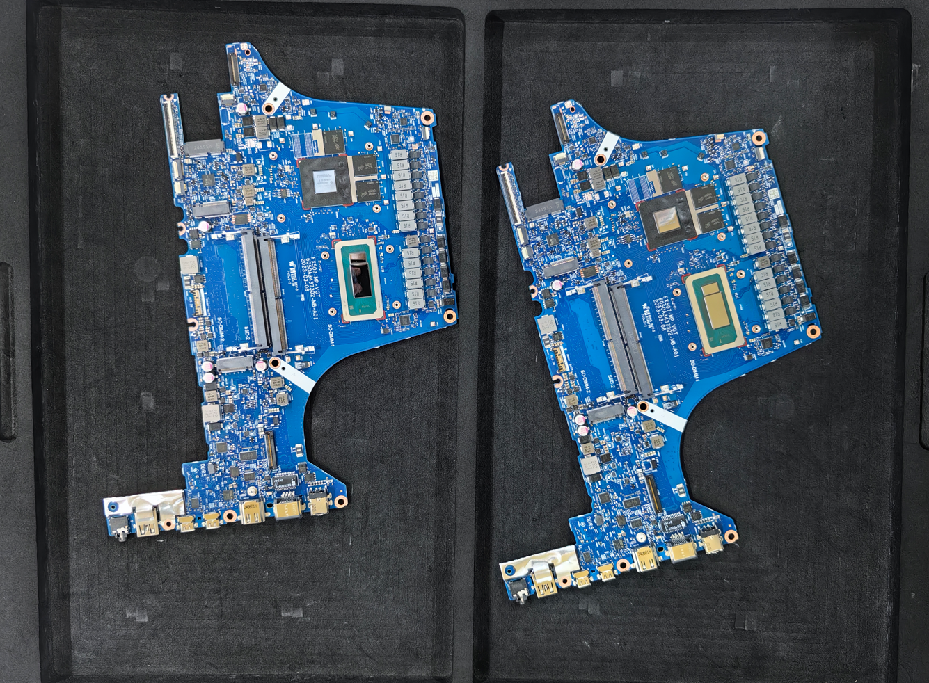
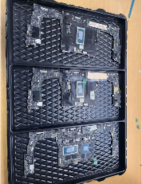
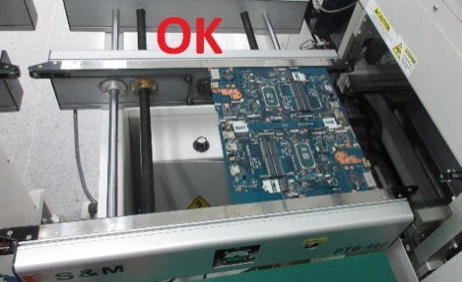
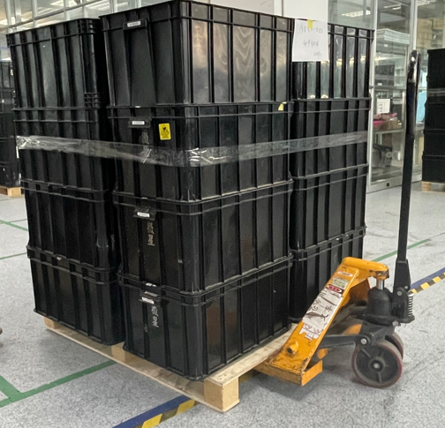
Back Up – Images of transport boards
Inventec CQ
Compal KS
Compal CD
MSI

Slide 53
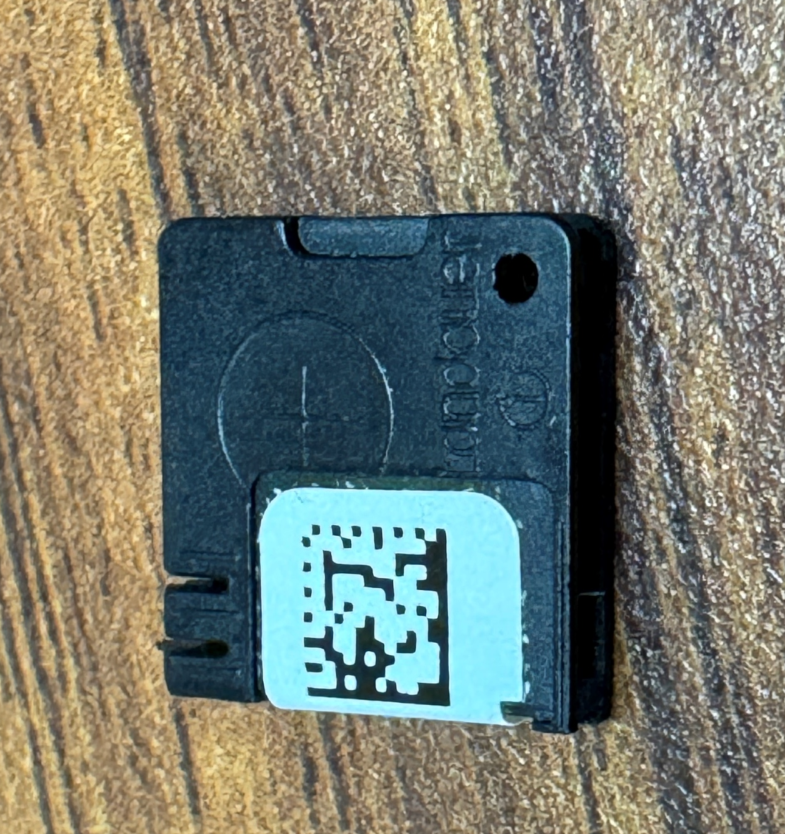
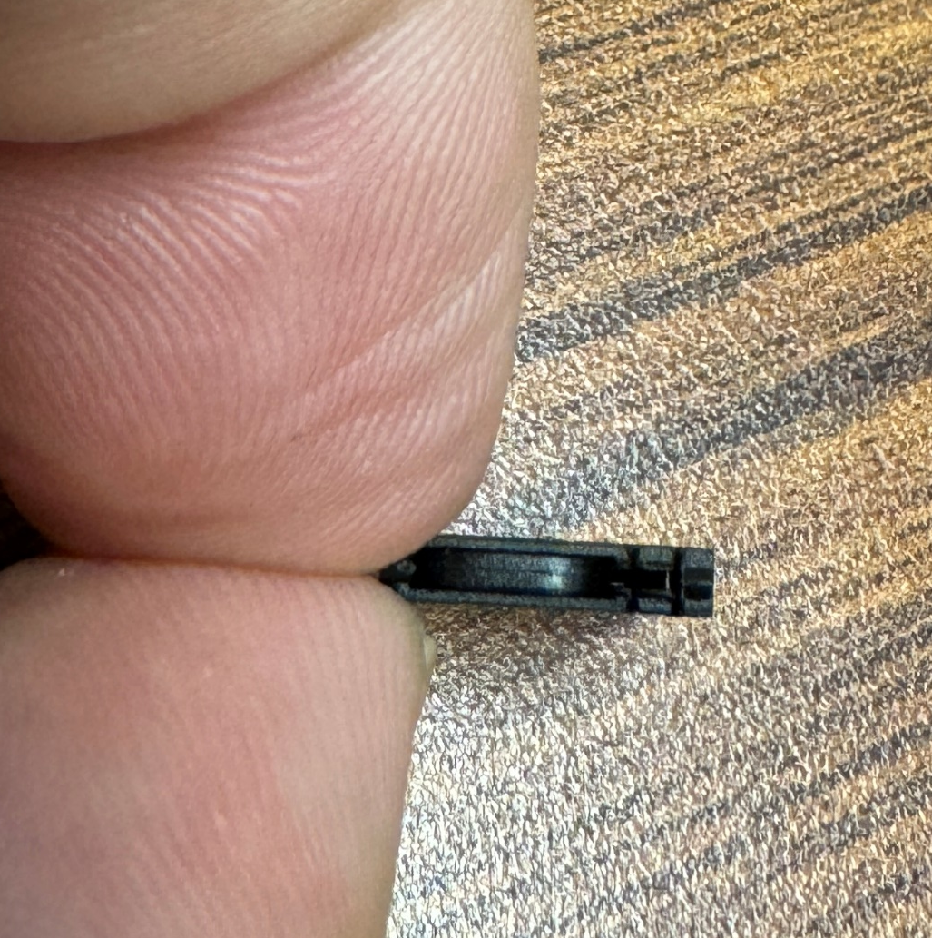
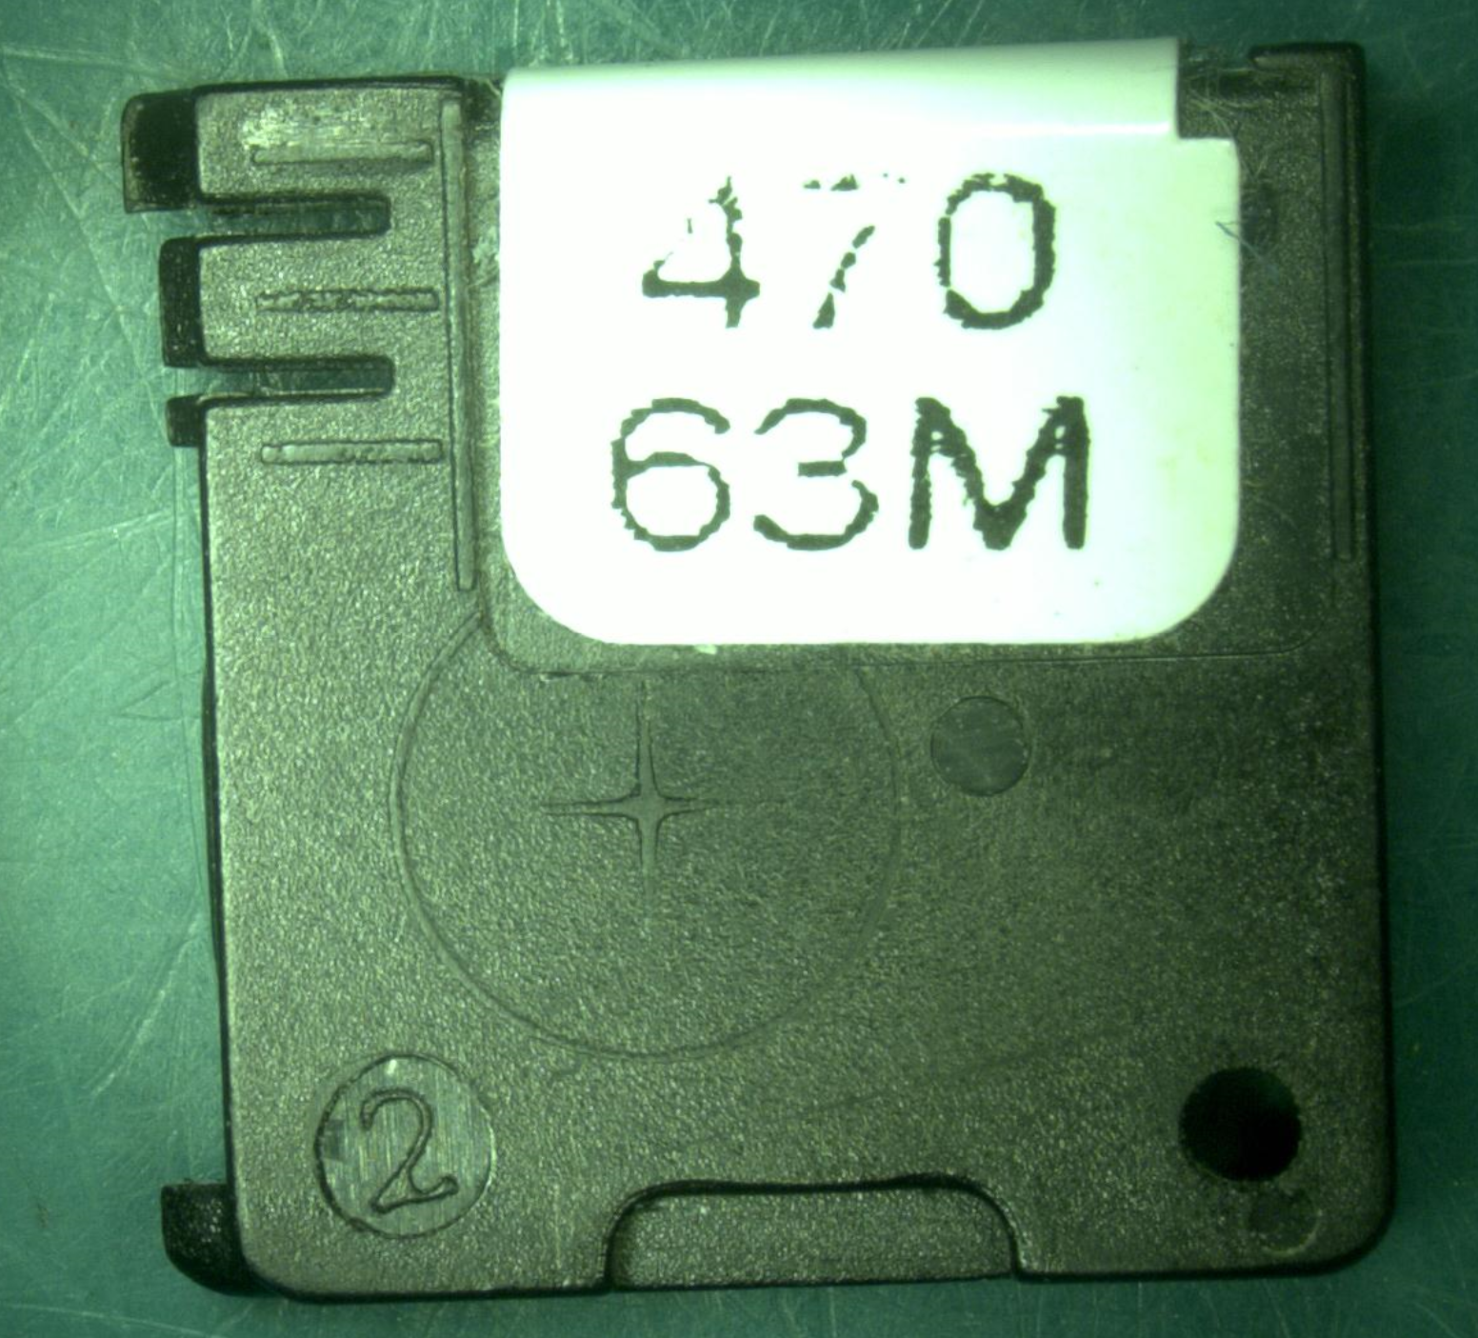
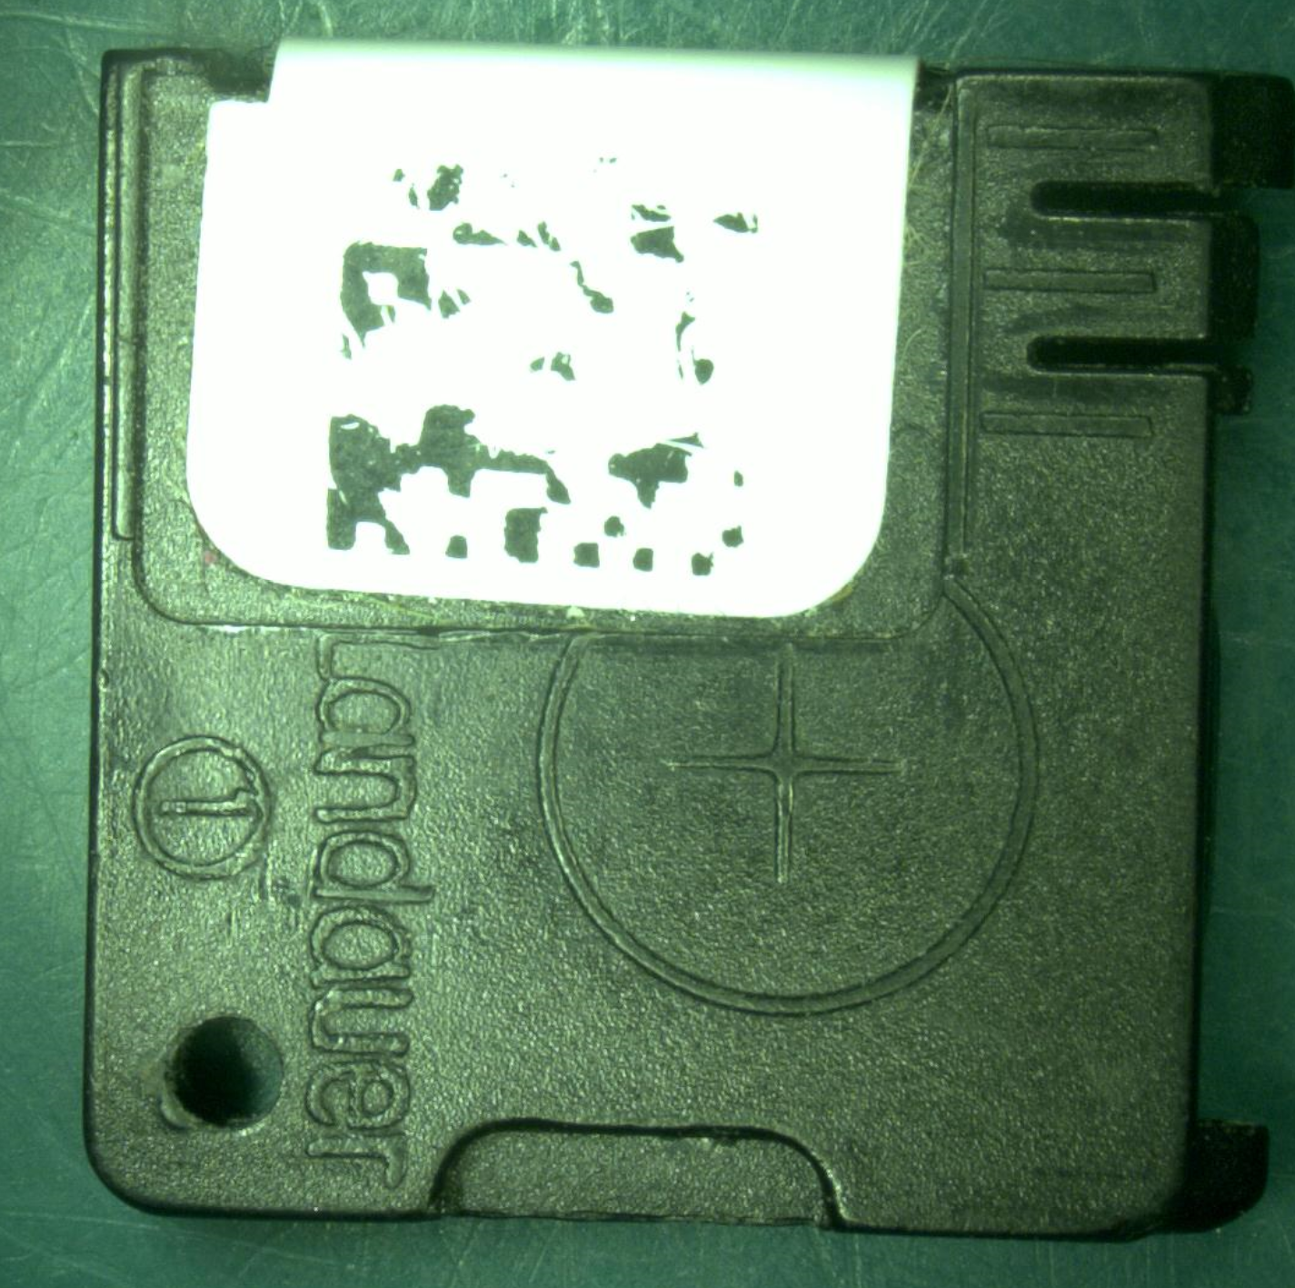
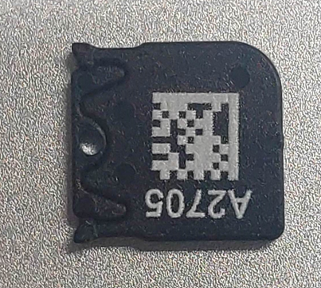
Back Up – Dosimeter
Quanta
Pega SZ
Inventec CQ

Slide 54
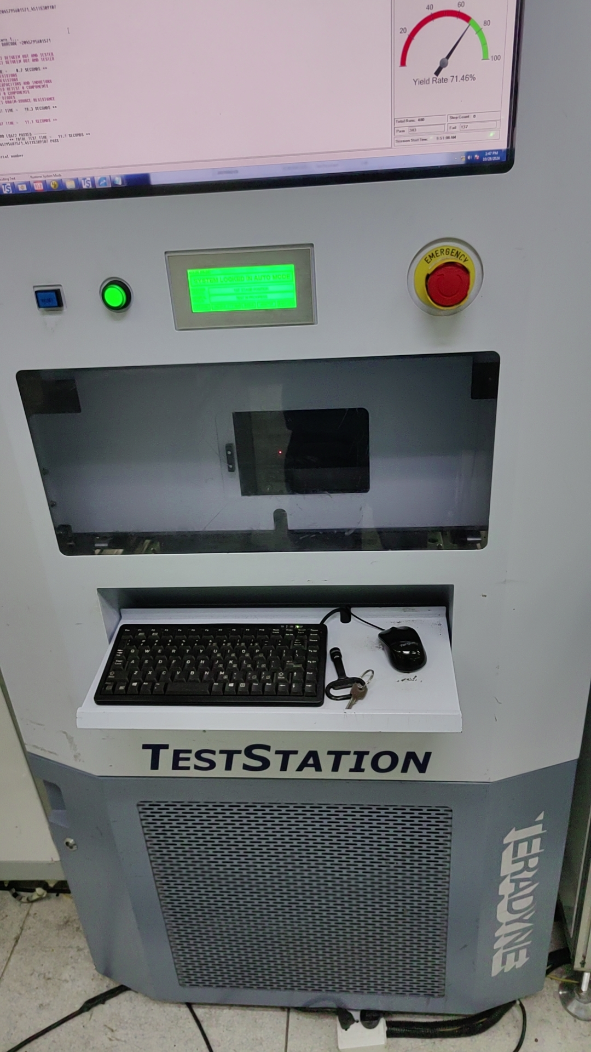
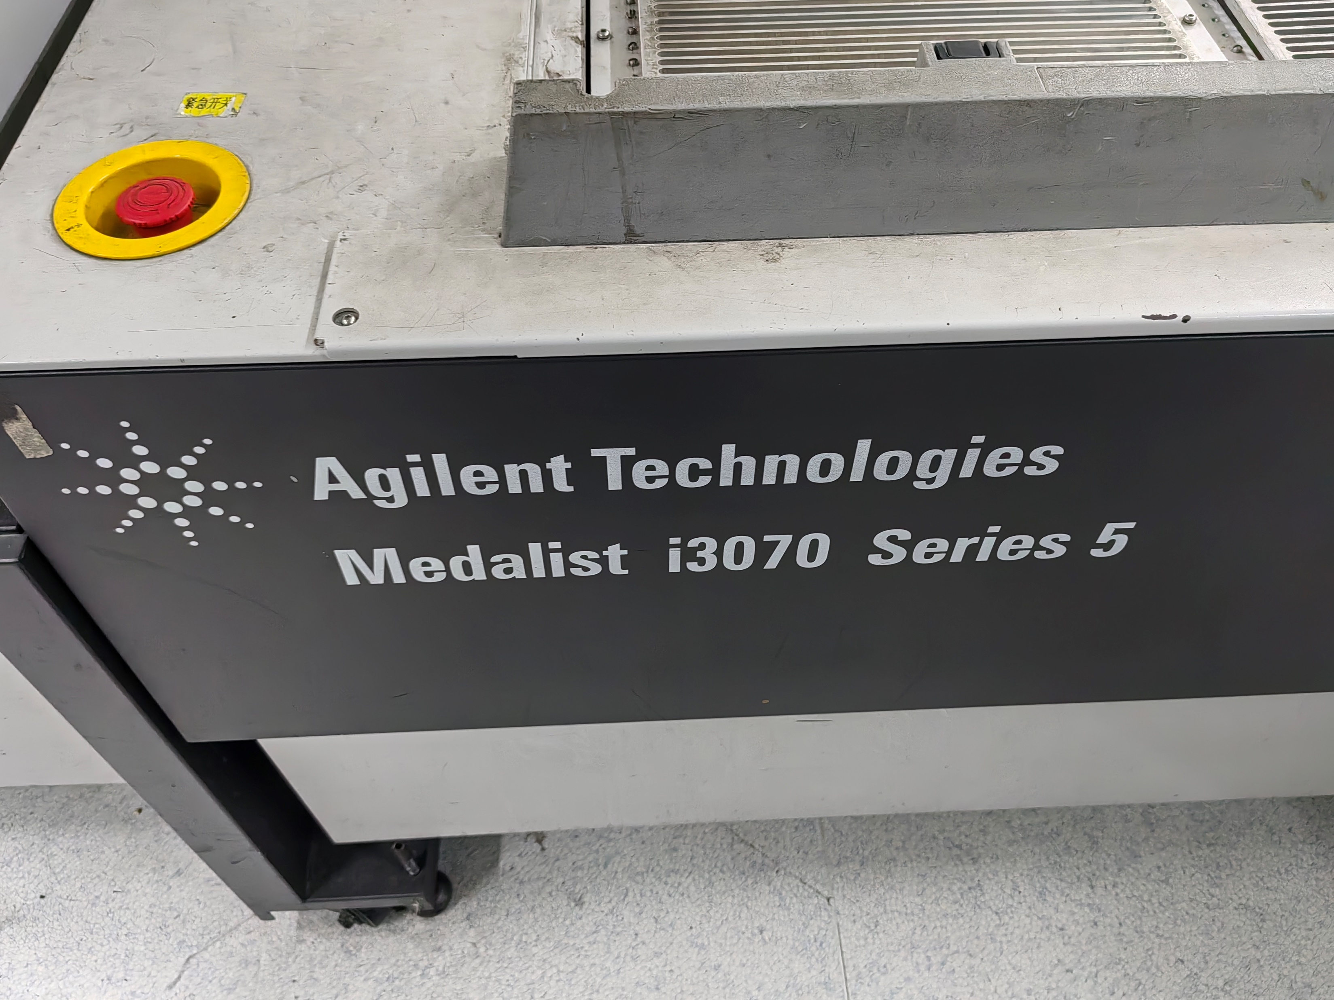
Back Up –LCFC ICT Equipment

